Slide 1
PES2PGE23DS126-Sandhya B S
File created on: 11/30/2025 9:33:24 AM

Slide 2
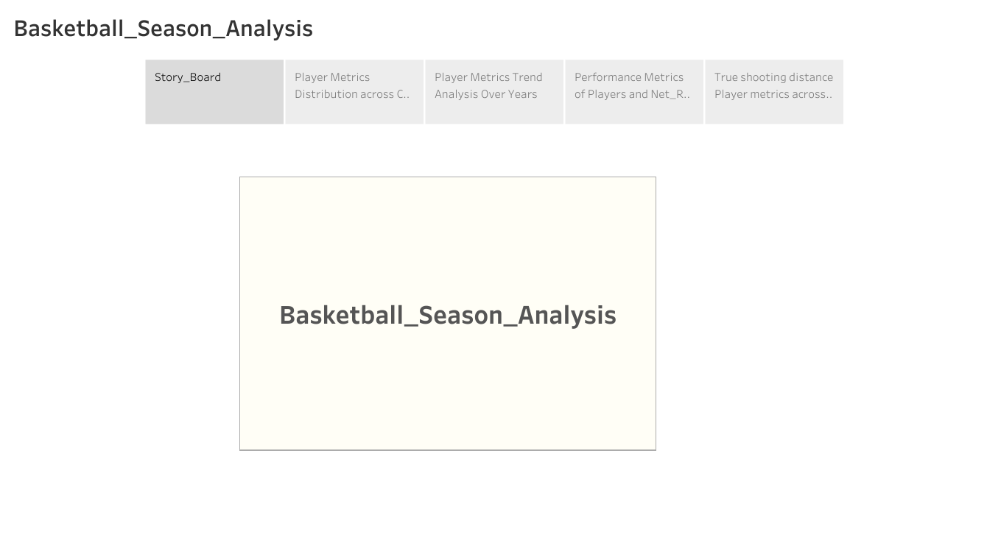

Slide 3
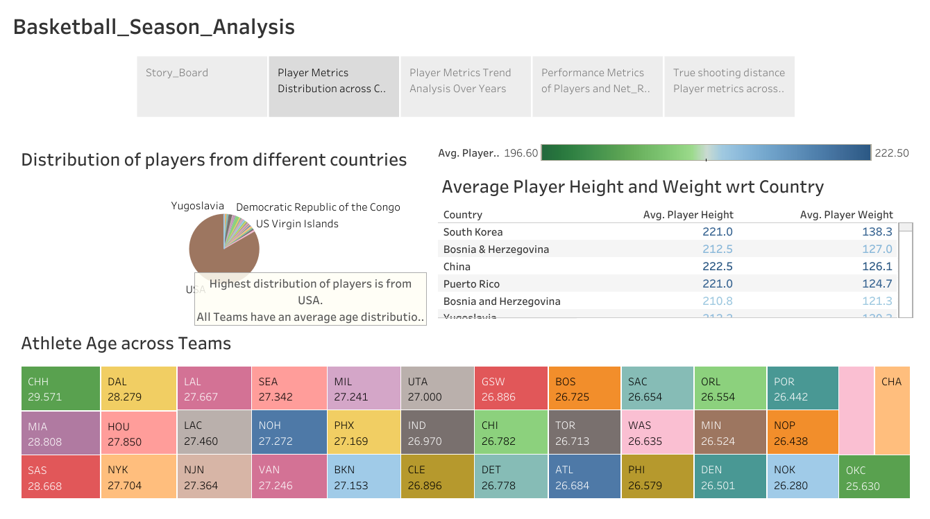

Slide 4
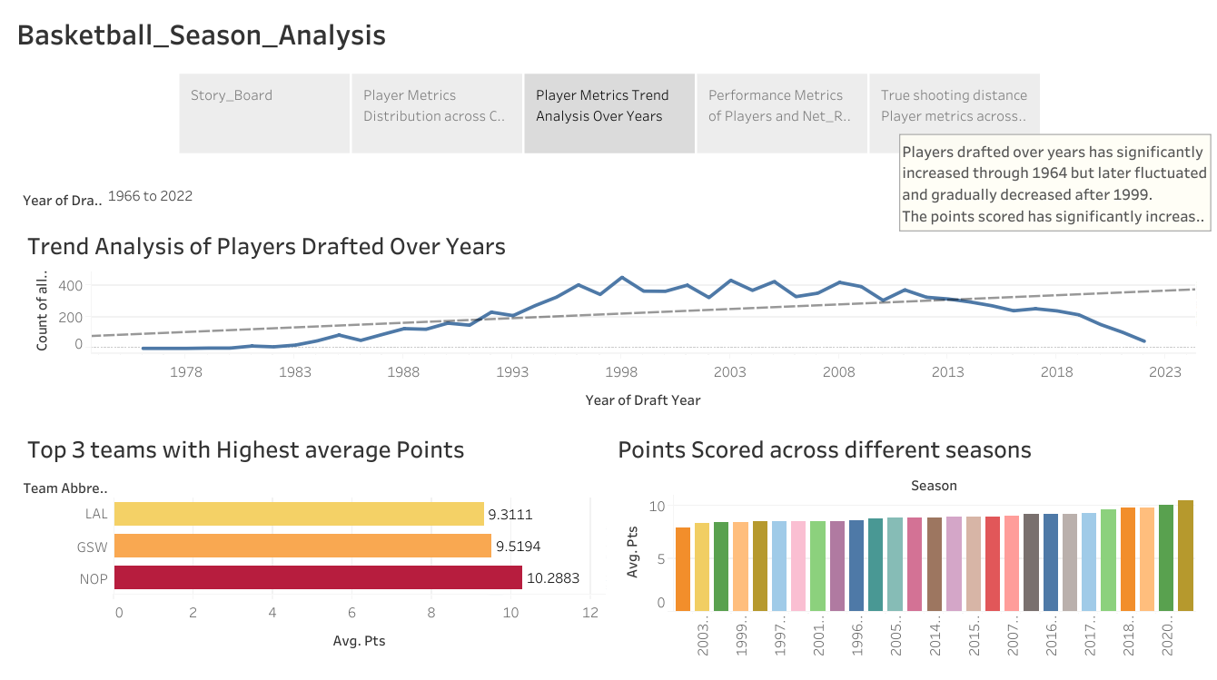

Slide 5
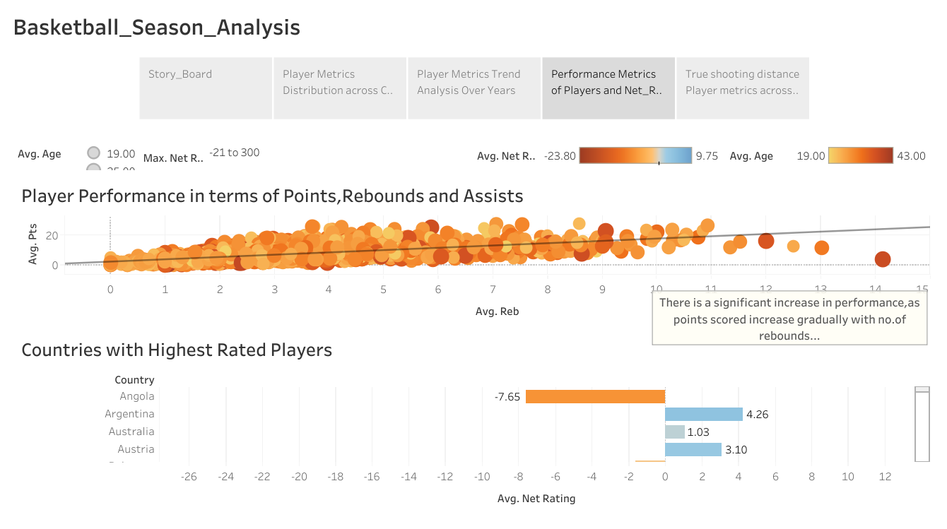

Slide 6
